Slide 1
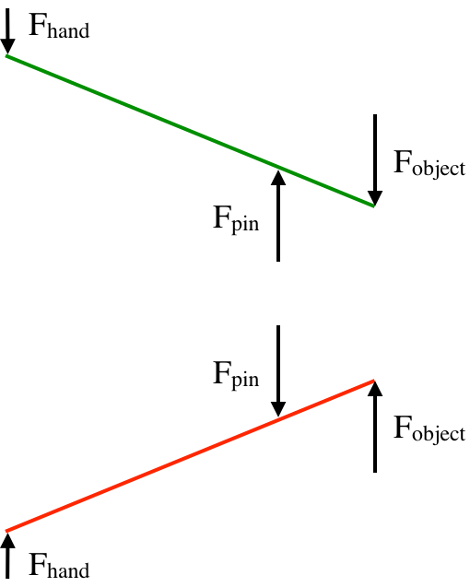
Aaron – 2/6/2016
Lengths are also important here!

Slide 2
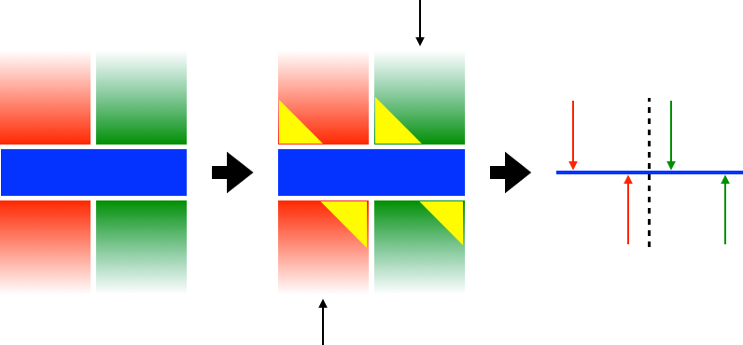
It’s unclear what the yellow triangles are, edge loading?
Would be helpful to have forces and length scales labeled

Slide 3
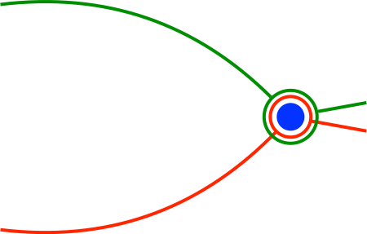
The color coding here is very clear
quack
Looks like a really fat hungry duck

Slide 4
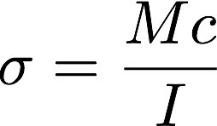
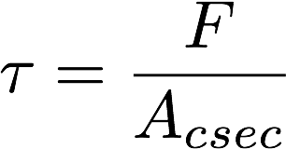
The lever arms weren’t defined in the previous images - careful
What moment of inertia are you using for modeling? Any particular value of sigma you’re interested in?

